Slide 1
Python Indentation
Most of the programming languages like C, C++, and Java use braces { } to define a block of code.
Python, however, uses indentation.
A code block (body of a function, loop, etc.) starts with indentation and ends with the first unindented line.
The amount of indentation is up to you, but it must be consistent throughout that block.
Generally, four whitespaces are used for indentation and are preferred over tabs.
for i in range(1,11):
print(i)
if i == 5:
break

Slide 2
Python Comments
Comments are very important while writing a program. They describe what is going on inside a program, so that a person looking at the source code does not have a hard time figuring it out
In Python, we use the hash (#) symbol to start writing a comment.
It extends up to the newline character. Comments are for programmers to better understand a program. Python Interpreter ignores comments.
#This is a comment
#print out Hello
print('Hello').
Multi-line comments:
use triple quotes, either ''' or """.
These triple quotes are generally used for multi-line strings. But they can be used as a multi-line comment as well. Unless they are not docstrings, they do not generate any extra code.
"""This is also a
perfect example of
multi-line comments"""

Slide 3
Docstrings in Python
A docstring is short for documentation string.
Python docstrings (documentation strings) are the string literals that appear right after the definition of a function, method, class, or module.
The docstrings are associated with the object as their __doc__ attribute.
Triple quotes are used while writing docstrings. For example:
def double(num):
"""Function to double the value"""
return 2*num
we can access the docstrings of the above function with the following lines of code:
print(double.__doc__)

Slide 4
Data Types
Python support 3 categories of data types:
Python Data Types
Basic Types
Container Types
User-define Types
int
list
float
class
tupe
bool
set
string
dict
bytes
complex

Slide 5
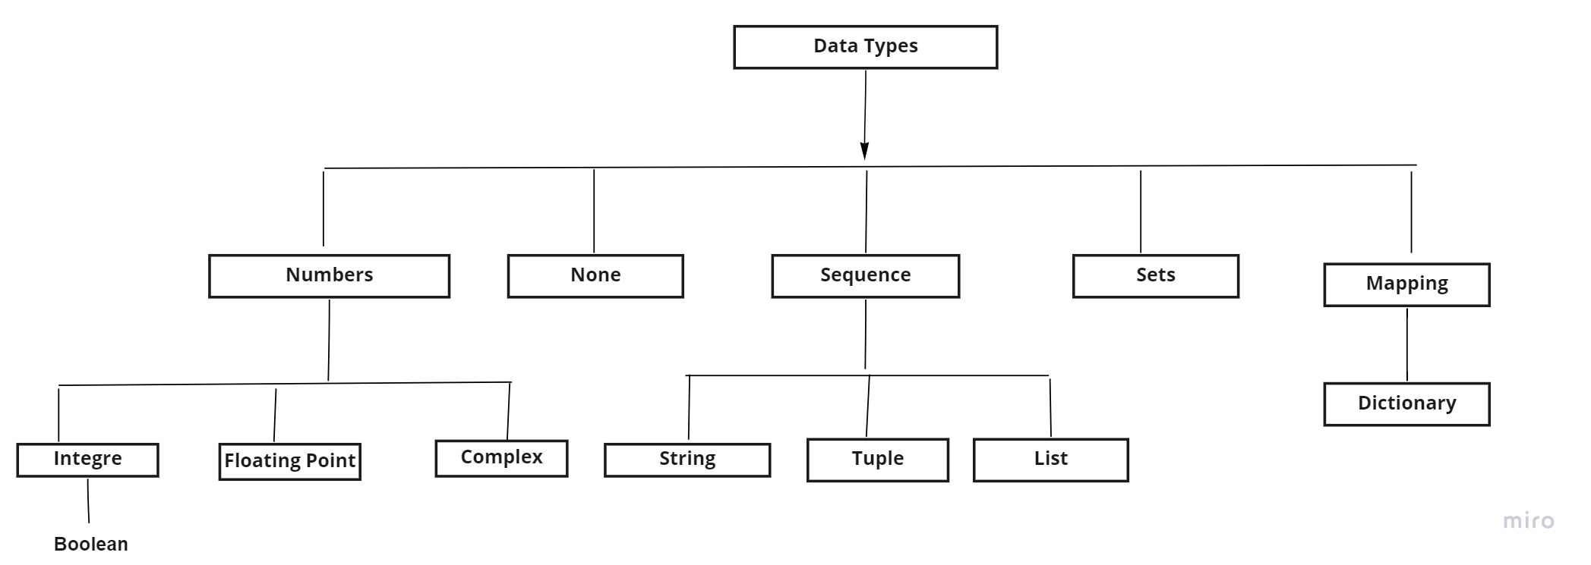
Data Types

Slide 6
Basic Types
It can be expressed in binary, decimal , octal , hexadecimal
Binary start with 0b/0B,
Octal starts with 0o/00,hexa with 0x/0X
Float can be expressed -310.256,207.369,
Complex contain real and imaginary part : 3 +2j, 1+4j
bool can take any of two Boolean values both staring in caps.
String is immutable collection of characters : ‘apple’, “apple”, ““”apple”””
Types of particular data can be check using type() function.

Slide 7
Variable Types and Assignment
There is no need to define type of a variable . During execution the type of the variable is inferred from the context in which it is being used.
Hence Python is called dynamically-typed language.
a =25 # type of a is inferred as int
a =504.6 #type of a is inferred as float
a =‘Hello” # type a is inferred as str
Multiple Variable Assignment:
a =10;b=66.30,name = ‘Rahul’
a, b, c = 10,66.30,’Rahul’
a=b=c=d = 10

Slide 8
Arithmetic Operators
Arithmetic operators are used to perform mathematical operations like addition, subtraction, multiplication, etc.
Operator | Meaning | Example
+ | Add two operands or unary plus | x + y+ 2
- | Subtract right operand from the left or unary minus | x - y- 2
* | Multiply two operands | x * y
/ | Divide left operand by the right one (always results into float) | x / y
% | Modulus - remainder of the division of left operand by the right | x % y (remainder of x/y)
// | Floor division - division that results into whole number adjusted to the left in the number line | x // y
** | Exponent - left operand raised to the power of right | x**y (x to the power y)

Slide 9
Comparison operators
Comparison operators are used to compare values. It returns either True or False according to the condition.
Operator | Meaning | Example
> | Greater than - True if left operand is greater than the right | x > y
< | Less than - True if left operand is less than the right | x < y
== | Equal to - True if both operands are equal | x == y
!= | Not equal to - True if operands are not equal | x != y
>= | Greater than or equal to - True if left operand is greater than or equal to the right | x >= y
<= | Less than or equal to - True if left operand is less than or equal to the right | x <= y

Slide 10
Logical operators
Logical operators are the and, or, not operators.
Operator | Meaning | Example
and | True if both the operands are true | x and y
or | True if either of the operands is true | x or y
not | True if operand is false | not x

Slide 11
Bitwise operators
Bitwise operators act on operands as if they were strings of binary digits. They operate bit by bit, hence the name.
In the table below: Let x = 10 (0000 1010 in binary) and y = 4 (0000 0100 in binary)
Operator | Meaning | Example
& | Bitwise AND | x & y = 0 (0000 0000)
| | Bitwise OR | x | y = 14 (0000 1110)
~ | Bitwise NOT | ~x = -11 (1111 0101)
^ | Bitwise XOR | x ^ y = 14 (0000 1110)
>> | Bitwise right shift | x >> 2 = 2 (0000 0010)
<< | Bitwise left shift | x << 2 = 40 (0010 1000)

Slide 12
Assignment operators
Assignment operators are used in Python to assign values to variables.
Operator | Example | Equivalent to
= | x = 5 | x = 5
+= | x += 5 | x = x + 5
-= | x -= 5 | x = x - 5
*= | x *= 5 | x = x * 5
/= | x /= 5 | x = x / 5
%= | x %= 5 | x = x % 5

Slide 13
Special operators
Identity operators:
is and is not are the identity operators in Python. They are used to check if two values (or variables) are located on the same part of the memory. Two variables that are equal does not imply that they are identical.
.
Operator | Meaning | Example
is | True if the operands are identical (refer to the same object) | x is True
is not | True if the operands are not identical (do not refer to the same object) | x is not True

Slide 14
Special operators
.
Membership operators:
in and not in are the membership operators in Python. They are used to test whether a value or variable is found in a sequence (string, list, tuple, set and dictionary).
Operator | Meaning | Example
in | True if value/variable is found in the sequence | 5 in x
not in | True if value/variable is not found in the sequence | 5 not in x

Slide 15
Conversion
int(float/numeric string) # from float/numeric string to int
int(numeric string, base) # from numeric string to int in base
float(int/numeric string) # from int/numeric string to float
complex(int/float) # convert complex with imaginary part 0
bool(int/float) # from int/float to True/False(1/0)
str(int/float/bool) # convert to string
chr(int) # yield character corresponding to int

Slide 16
Thank You

